Slide 1
Static Analysis
James Walden
Northern Kentucky University

Slide 2
Topics
Why Static Analysis?
False Positives and Negatives
Static Analysis Internals
Using the Tools

Slide 3
What is Static Analysis?
Static = without program execution
Includes everything except testing.
Usually used to refer to compiler type tools.
Examples
Static type checking
Vulnerability detection tools
Formal methods

Slide 4
Why Static Analysis?
Code reviews require substantial expertise in secure programming.
Human readers are fallible and will miss mistakes.
Code reviews are slow. Unreviewed legacy code will take time to review.

Slide 5
Verification Techniques
Formal
Verification
Static
Analysis
Assurance
Code
Review
Security
Testing
Penetration
Testing
Cost

Slide 6
False Negatives and Positives
False Positives
Tool reports bugs in code that aren’t there.
Complex control or data flow can confuse tools.
False Negatives
Tool fails to discover bugs that are there.
Code complexity or lack of rules to check.
Notes:
Tainting in perl/ruby.

Slide 7
False Negatives and Positives
False Positives
Mistakes
False Negatives
Check Heuristics

Slide 8
Static Analyis Approaches
Standard compiler warnings and type checking.
Lexing source checkers that look for bad names like strcpy() and gets().
Parsing source code checkers.
Parsing checkers with annotations.
Formal proof based program verification.

Slide 9
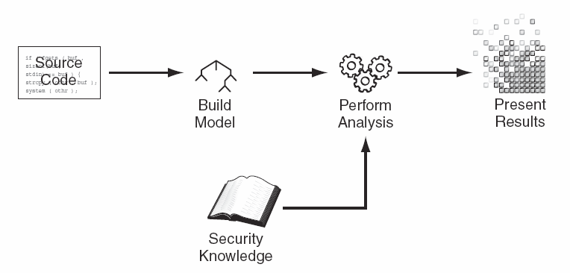
Static Analysis Internals
Parser
Model Builder
Analysis Engine

Slide 10
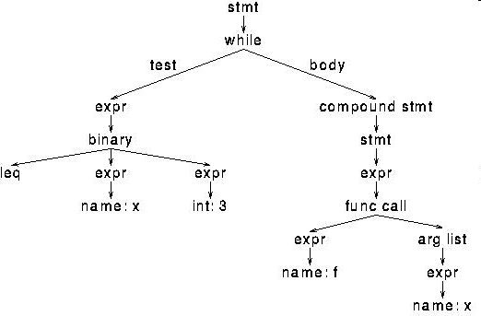
Parser
Convert programming language to AST.
Must have a parser for each language that tool supports.
Abstract Syntax Tree

Slide 11
Control Flow Graph
if(a > b)
nConsec = 0
s1 = getHexChar(a)
s2 = getHexChar(b)
return nConsec

Slide 12
Data Flow with SSA
Source Code:
if (bytesRead < 8) {
tail = (byte) bytesRead;
}
SSA Form:
if (bytesRead₁ < 8) {
tail₂ = (byte) bytesRead₁;
}
tail₃ = φ(tail₁, tail₂);

Slide 13
Taint Propagation
Track flow of data from source to sink.
Source: where data comes into program.
Sink: function that consumes the data.
Vulnerabilities reported if
Data comes from an untrusted source.
Data consumed by a dangerous sink.
No function between source and sink makes the data safe.

Slide 14
Tainting SQL Injection Example
$link = mysql_connect($DB_HOST, $DB_USERNAME, $DB_PASSWORD) or die ("Couldn't connect: " . mysql_error());
mysql_select_db($DB_DATABASE);
$username = $_GET[‘username’];
$password = $_GET[‘password’];
$query = "select count(*) from users where username = '$username' and password = '$password'";
$result = mysql_query($query);
Source
Source
Sink

Slide 15
Local vs. Global Analysis
Local Analysis: Analysis of an individual function, a.k.a. intraprocedural analysis.
Global Analysis: Follows control and data flow between functions, a.k.a. interprocedural analysis.

Slide 16
Rules
Security knowledge base for tool.
Identify data sources.
Identify data sinks.
Model behavior of validation functions.
Check for dangerous configurations.
Check control flow (i.e. every lock released.)
Customize for process + project
Check coding style is obeyed.
Check for custom functions, standards.

Slide 17
Static Analysis Tools
Simple search (lexing) tools
Flawfinder
ITS4
RATS
Parsing Tools
Fortify Source Code Analyzer
Coverity Prevent
Klocwork K7 Suite
FindBugs
splint

Slide 18
Using the Tools
Who runs the tools?
Developers
Security team
When do you run the tool?
While code is being written (IDE integration)
Before code check-in
After each build
After major milestones
What do you do with the results?
Support code review process.
Support security metrics.
Use to decide if project should be released.

Slide 19
Code Reviews
Review
Results
Run Tool
Review
Code
Update
Rules
Fix Bugs

Slide 20
Static Analysis Metrics
Vulnerability density (vulns/KLOC)
Vulnerabilities divided by severity
Critical, high, medium, low
Vulnerability types
Injection, XSS, race conditions, etc.
Vulnerability dwell
How long bug remains in code after detection.
Audit coverage
Percentage of code covered by reviews.

Slide 21
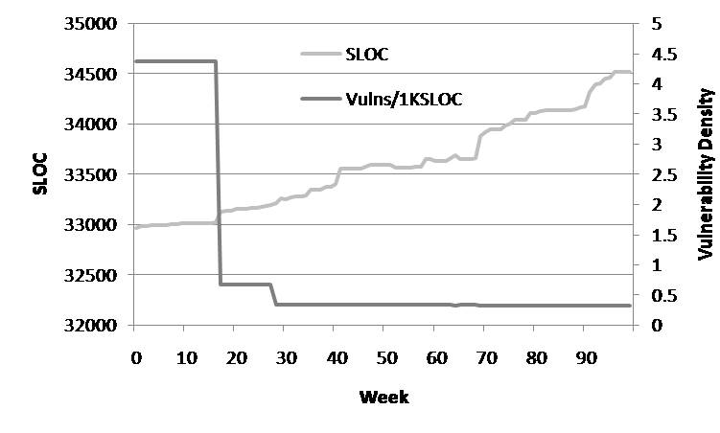
Evolution of a Single Project

Slide 22
Key Points
Static Analysis
Source code needed, but not execution.
Fast, repeatable, objective analysis.
Sources and Sinks
Malicious input enters program via sources.
Exploitation occurs at the sink.
Mistakes
False positives
False negatives

Slide 23
References
Brian Chess and Jacob West, Secure Programming with Static Analysis, Addison-Wesley, 2007.
Eoin Keary et. al., OWASP Code Review Guide 1.1, http://www.owasp.org/index.php/Category:OWASP_Code_Review_Project, 2008.
Gary McGraw, Software Security, Addison-Wesley, 2006.
PCI Security Standards Council, PCI DSS Requirements and Security Assessment Procedures, v1.2, 2008.
Karl Wiegers, Peer Reviews in Software, Addison-Wesley, 2002.

